Slide 1
Module 5
Explainer Video 1

Slide 2
SQL Joins
Inner Join
Outer Join
Left outer join
Right outer join

Slide 3
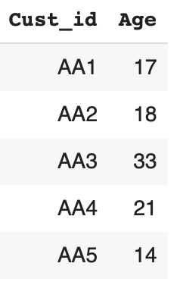
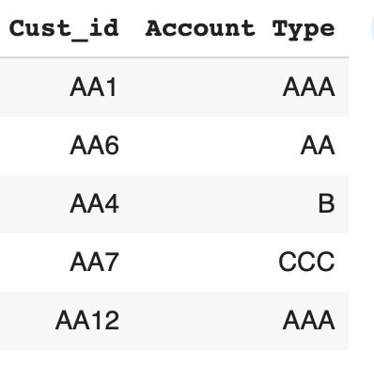
Inner Join
Customers
Accounts

Slide 4
Inner Join
Customers
Accounts
We join in such a way that only matching rows are returned in the joined table.

Slide 5
Inner Join
Customers
Accounts
We join in such a way that only matching rows are returned in the joined table.

Slide 6
Inner Join
Customers
Accounts
We join in such a way that only matching rows are returned in the joined table.

Slide 7
Inner Join
Customers
Accounts
We join in such a way that only matching rows are returned in the joined table.

Slide 8
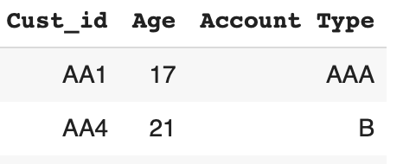
Inner Join
Customers
Accounts
We join in such a way that only matching rows are returned in the joined table.

Slide 9
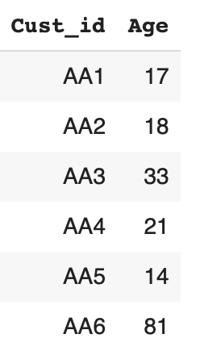
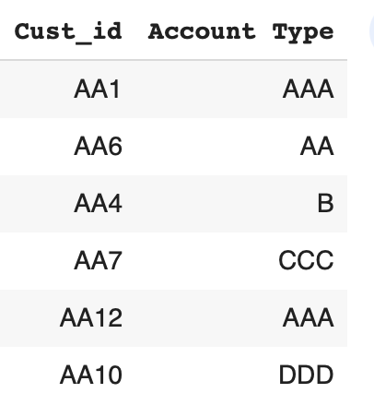
Outer Join
Customers
Accounts
Rows of both the tables are returned, in case there is no match then null values are returned

Slide 10
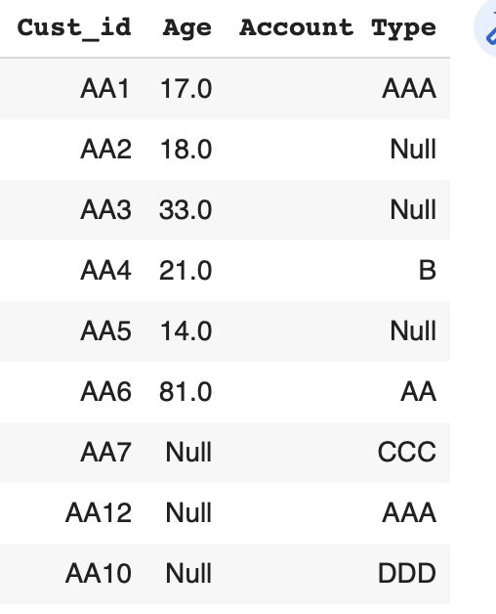
Outer Join
Customers
Accounts
Rows of both the tables are returned, in case there is no match then null values are returned

Slide 11
Outer Join
Customers
Accounts
Rows of both the tables are returned, in case there is no match then null values are returned

Slide 12
Outer Join
Customers
Accounts
Rows of both the tables are returned, in case there is no match then null values are returned

Slide 13
Outer Join
Customers
Accounts
Rows of both the tables are returned, in case there is no match then null values are returned

Slide 14
Left Outer Join
Customers
Accounts
All the rows of the left table are returned and only matching rows of right table are returned. Wherever there is no match in the right table null values are returned

Slide 15
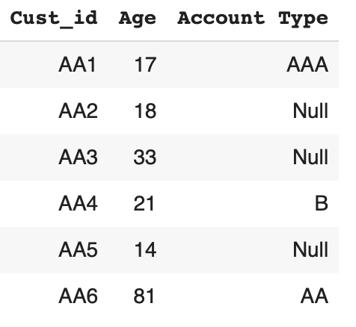
Left Outer Join
Customers
Accounts
All the rows of the left table are returned and only matching rows of right table are returned. Wherever there is no match in the right table null values are returned

Slide 16
Left Outer Join
Customers
Accounts
All the rows of the left table are returned and only matching rows of right table are returned. Wherever there is no match in the right table null values are returned

Slide 17
Left Outer Join
Customers
Accounts
All the rows of the left table are returned and only matching rows of right table are returned. Wherever there is no match in the right table null values are returned

Slide 18
Left Outer Join
Customers
Accounts
All the rows of the left table are returned and only matching rows of right table are returned. Wherever there is no match in the right table null values are returned

Slide 19
Right Outer Join
Customers
Accounts
All the rows of the right table are returned and only matching rows of left table are returned. Wherever there is no match in the left table null values are returned

Slide 20
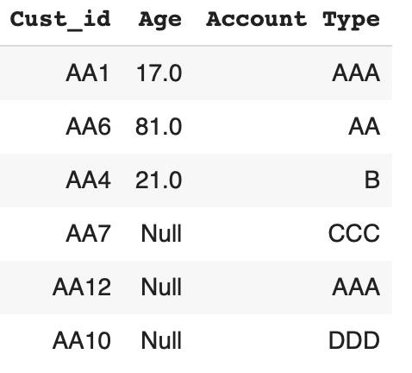
Right Outer Join
Customers
Accounts
All the rows of the right table are returned and only matching rows of left table are returned. Wherever there is no match in the left table null values are returned

Slide 21
Right Outer Join
Customers
Accounts
All the rows of the right table are returned and only matching rows of left table are returned. Wherever there is no match in the left table null values are returned

Slide 22
Right Outer Join
Customers
Accounts
All the rows of the right table are returned and only matching rows of left table are returned. Wherever there is no match in the left table null values are returned

